Slide 1
HG Vora Case Study

Slide 2
The analysis was done on comparing Inflation (CPI) with Interest Rate (Fed Funds Rate).
CPI had to be converted from an index value to month over month change.
Fed Funds Rate, which is available as a daily rate, was averaged for each Year and Month.
Correlation coefficient of -0.31 was calculated, showing a moderate negative.
Python
Libraries used: Pandas, Numpy, Matplotlib
BI Visualization (Power BI)
User Interaction
Allow the user to select from 14 different economic indicators.
Pulled from FRED via API calls.
Drill Through available from the table below the line graphs.
Misc. (Web Version only)
Downloadable as PDF
Semantic Model accessible via excel to leverage existing relationships

Slide 3
Power BI

Slide 4
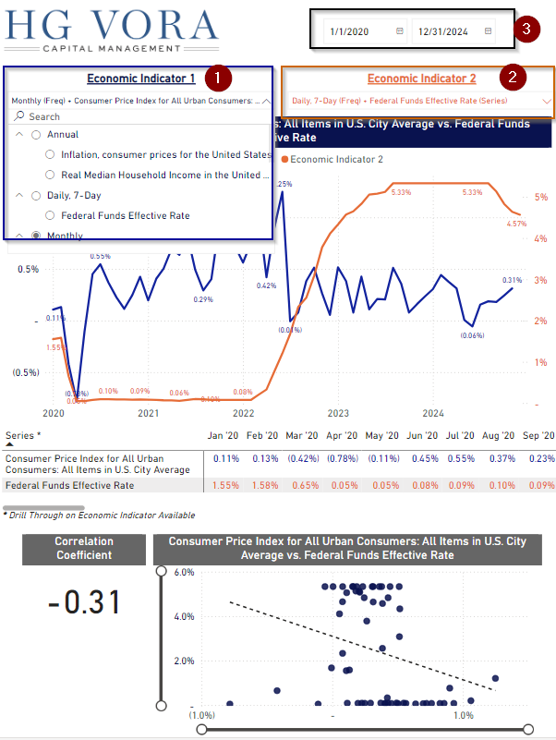
In the main page, you can compare any of the 14 economic indicators against each other, via selecting them under ‘Economic Indicator 1’ (1) and ‘Economic Indicator 2’ (2).
Change Date Range with date slicer

Slide 5
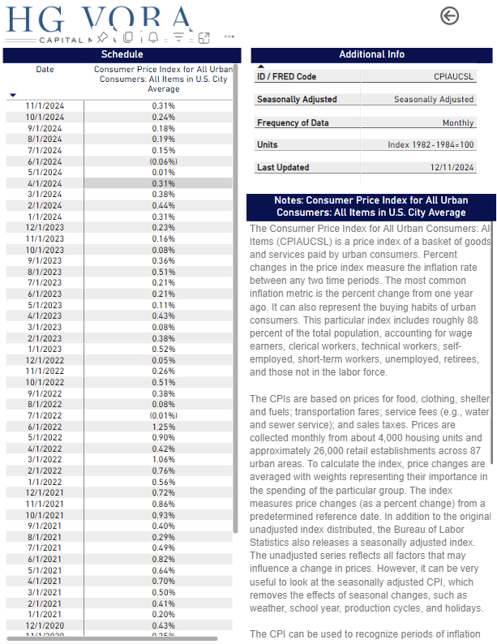
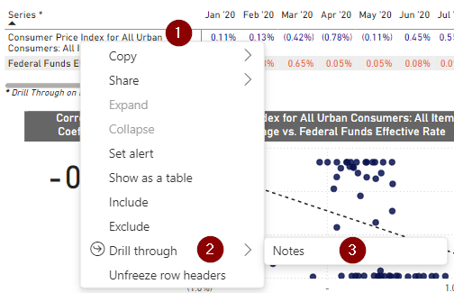
To view additional color on either selected indicators, one can Drill Through by right clicking on the indicator and selecting Drill Through. In the example below,
1.) Right click on ‘Consumer Price Index…’ (CPI)
2.) In the window that opens, select ‘Drill through’
3.) Click on ‘Notes’

Slide 6
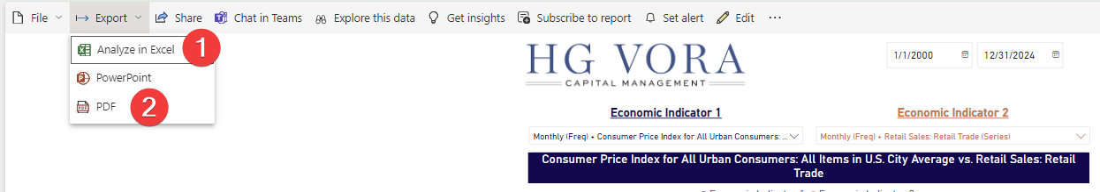
There are multiple ways to download and analyze the data/report (Power BI Online / Web Service).
1.) One can connect to the CDM / Semantic Model through excel and leverage the relationships via pivot tables for further (self) data exploration.
2.) One can also download the reports as PDF. Since the dashboards were created in a letter format, the files will be printed out as such.

